Slide 1
Towards distributed Image Reconstruction
Jonas Schwammberger
Institute for Data Science
FHNW

Slide 2
Topics
Large data volume for radio interferometric image reconstruction
Problem: Software does not scale with data volume
Solution: Distributing the image reconstruction
Image reconstruction consist of two parts Major/Minor cycle
Distributing the major cycle has been handled
This presentation is about distributing the minor cycle

Slide 3
Distributing the major/minor cycle using MPI and .netcore (C#)
Distributed gridding is based on the Image Domain Gridder (IDG)
Preliminary results

Slide 4
Major/Minor Cycle

Slide 5
What can we distribute?

Slide 6
Distributed gridding
~ 4 GB
32k * 32k image
1000+ GB

Slide 7
The Image Domain Gridder
From Veeneboer et al.

Slide 8
Minor Cycle Deconvolution
Compressed Sensing

Slide 9
But what about the minor cycle?
Deconvolution may become the most time consuming step
Deconvolution is done only on one node
All other nodes idle during deconvolution
We can use the idling nodes for deconvolution

Slide 10
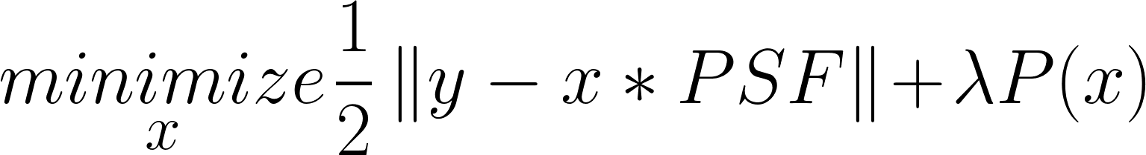
Compressed Sensing based deconvolution
PSF represents the instrument
P() represents the prior knowledge about our image
Optimization algorithm: Gradient Descent, ADMM…
CLEAN can be seen as a Compressed Sensing based deconvolution

Slide 11
The Point Spread Function
Represents the degradation from the interferometer

Slide 13
Minor cycle distribution can exploit the data properties
How large is the PSF
How large is the grid vs. the visibilities
How sparse is the model image
…
Test on a real world MeerKAT observation

Slide 14
Compressed Sensing

Slide 15
Compressed Sensing based deconvolution
P() → ElasticNet
Optimization Algorithm → Coordinate Descent

Slide 16
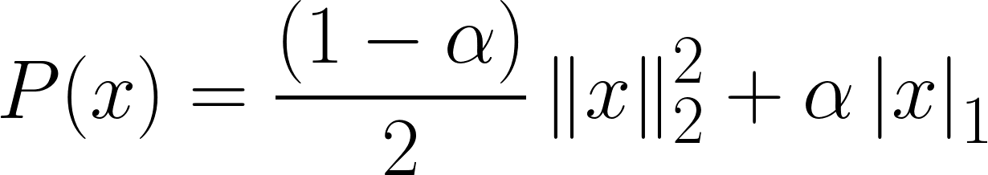


ElasticNet Prior
Mixture between L1 and L2 Norm

Slide 17
Coordinate Descent algorithm
Algorithm:
Minimizes one pixel at a time
Iterate over pixels (with some strategy) until convergence
Effective for high-dimensional problems
Parallel/Distributed/GPU variants

Slide 18
Distributed Coordinate Descent
(Code)

Slide 19
Distributed major / minor cycle

Slide 20
Preliminary results

Slide 21
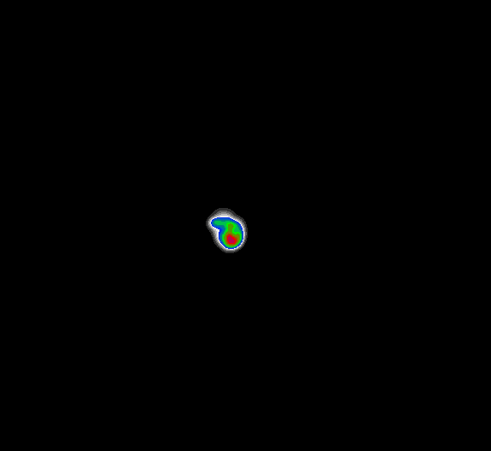

Preliminary Results
1 Node vs 4 Nodes
Speedup of a factor 3.2

Slide 22
Limitations
Distributed Coordinate Descent is latency limited
GPU Acceleration
Data volume not (yet) representative

Slide 23
Further steps
GPU Acceleration

